Slide 1
Ion and Atom traps at
Laboratoire de Physique Corpusculaire de Caen
Slides from X Flechard, JF Cam, E Lienard
Introduction/History
LPC Trap
MOTRIMS
SPIRAL II
EMILIE
High Intensity
S3 Low Energy
QMS/PILGRIM
Conclusion

Slide 2
Introduction/History
The devices we have develloped were built either for a physics case
Or a genral purpose beamlne
E.U. Networks Exotraps/Eurotraps….
-Precision/high sensitivity NP beyond the SM
1997 … LPC Trap
-Ion/atoms collisions
2003 … Motrims
-DESIR , Decay Excitation Spectroscopy with Radioactive Ions
2006….SHIRAC
-Nuclear structure
2012…EMILIE
2012…S3 Low energy Beam lines

Slide 3
Technologies
-Simulations
-Mechanical design
-RF electronics
-High Voltage
-Vacuum calculations
-Diagnostics
-Slow control
…
=
PEOPLE

Slide 4

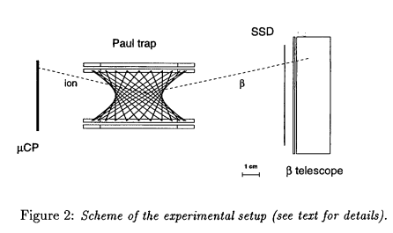
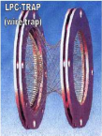
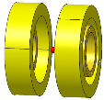
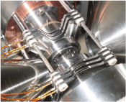
LPC Trap
Precision measurements in beta-decay constitute very sensitive tools to test some aspects of the Standard Model!
→ Fundamental symmetries of weak interaction
The LPCTrap experiment @ GANIL:
β−ν angular correlation parameter a_{βν}
(for allowed transitions, non-oriented nuclei)
a (C_{S}, C_{V}, C_{T}, C_{A}) → tests of V-A theory
a (ρ) + Ft → V_{ud} from mirror decays
a inferred from β–ion coincidences
Decay rate:
a
Paul trap
β
recoil

Slide 5
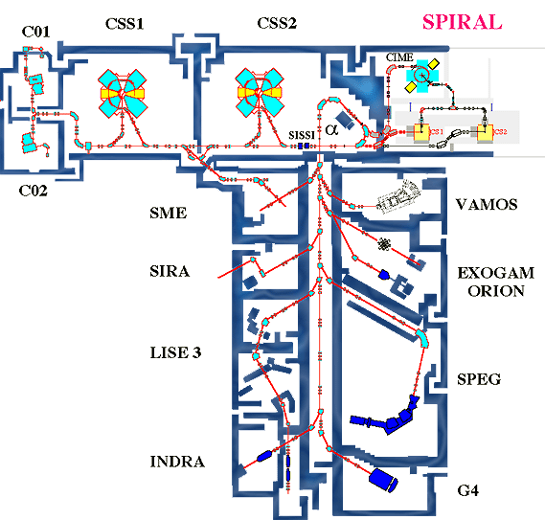
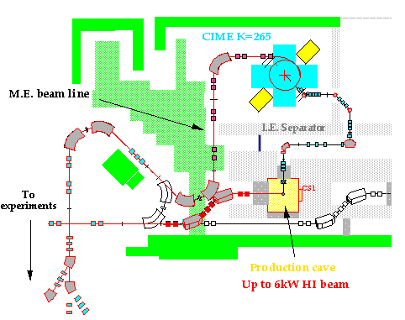
16
LPC Trap
LIRAT
Beams characteristics:
10-30 keV, 80 π mm mrad
rate: 10⁷ - 10⁸ ions/s
LIRAT
LPCTrap
Production target
ECR source
SPIRAL beam :
10-30 keV
ΔE ~ 20eV
?
Paul trap :
Effective potential :
2-3 V

Slide 6
Cooling ?
Cooling is phase space reduction i.e. emittance reduction
It can only occur with dissipative forces like buffer gas collisions
Resistive, laser…
Cooling a beam tends to reduce the emittance and increase
the brightness
B=I/ε_{x}ε_{y} you can also add the E spread B=I/ε_{x}ε_{y} ΔE
high brightness=high quality beam= pin point beam=all RIB in
« one point »
For radioactive ions the universal, fast, cheap technique is
buffer gas cooling inside a trapping device
The ion lose their energy by colliding with the buffer gas
the ion trapping keep the ion as a beam or as a bunch

Slide 7
Ion cooling principle
Goal: beam emittance reduction
Ion deceleration @ E=100eV
4 simultaneous actions on the beam:
Cooling : ion – gaz interaction interaction
Trapping: radial RF electric field
Guiding: axial DC electric field
Injection lenses
Extraction lens
Helium injection
Grounded injection electrode
Grounded
extraction lenses
Ion @ E=100eV
VRF
+VDC
VRF
+VDC
VRF
+VDC
VRF
+VDC
VRF
+VDC
VRF
+VDC
VRF
+VDC
VRF
+VDC
Ion beam
E= 60 keV
ε=80π.mm,mrad
VRF
+VDC
E=59,9keV
ε<3π.mm.mrad
VRF
+VDC
VRF
+VDC
VRF
+VDC
VRF
+VDC
VRF
+VDC
VRF
+VDC
VRF
+VDC
Quadrupolar Structure
Injection cell
Quadrupole vaccum chamber
Extraction cell
DC potential for ion guiding
VRF
VDC
High voltage
platform
RF voltage for trapping
Deceleration voltage: HV≈60kV-100V

Slide 8
Low Energy Beam line at GANIL
RFQ
(Cooling & bunching)
Pulsed cavity
Pulsed cavity
Paul Trap
Beam from
LIRAT
HV
KE_{ion} :
10 keV
100 eV - <1 eV
1 keV
100 eV
0 eV
ΔKE:
~20 eV
~1 eV
~0.1 eV
~ 10⁸ ⁶He⁺/s
buffer-gas: H₂ / He
accumulation: 200ms (cycle)
~2 10⁴ ⁶He⁺ /cycle
Total efficiency: ~ 10⁻³-10⁻²

Slide 9
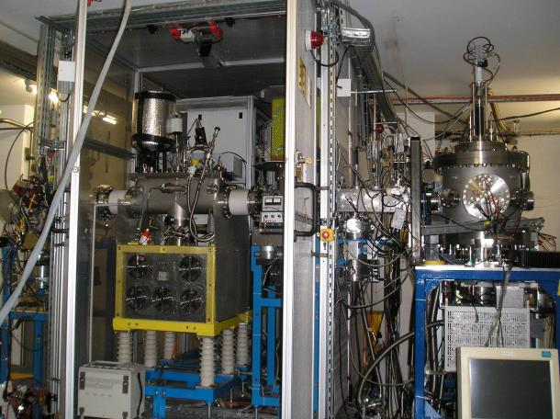
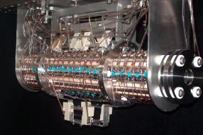
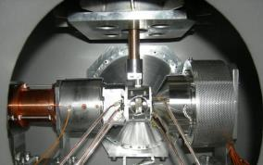
Experimental method: LPCTrap @ GANIL
LIRAT
Paul trap
& detection
chamber
RFQCB

Slide 10
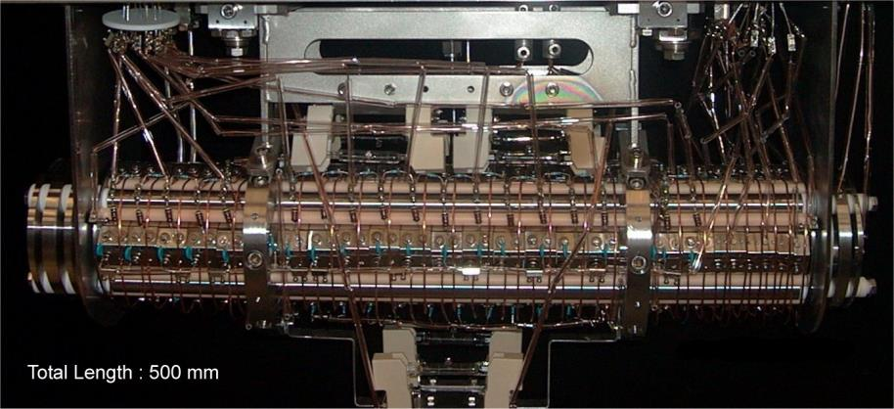
RFQ Cooler Buncher
UHV 10-8 torr
RF : f : 0.8 to 2 MHz
Parameters V₀ : 100 to 250 Volts
Pressure : some mTorr
of Hydrogen

Slide 11
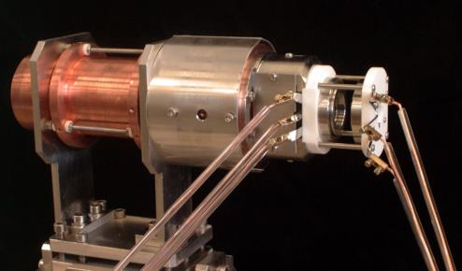
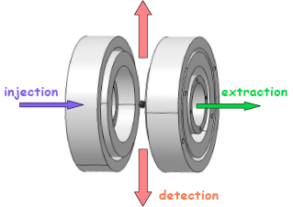
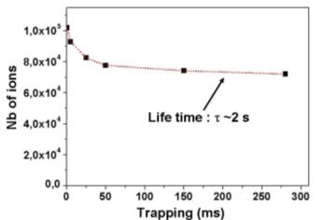
The transparent Paul trap (Delahaye 2002)
1 cm
6 rings, open geometry
1 mm³ cloud
potential well ~ 10 Volts
Injection : 20 %
Capacity : > 10⁵ ions
Life time : > 1 second
1 cm
(⁶Li⁺ ions,V_{RF} = 120 Vpp, f_{RF} = 1.15 MHz)

Slide 12
LPC Trap
Helium 6
Argon 35
Physics results underway…

Slide 13
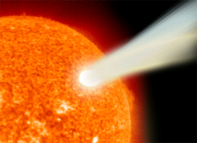
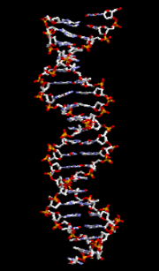
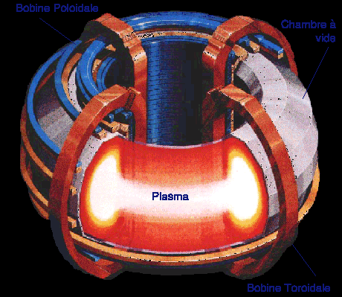
ATOM trap
Ion/Atoms collisons
  A^{q+} + B → A^{(q-r)+} + B^{r+} Electronic Capture
  A^{q+} + B → A^{q+} + B^{r+}+re⁻ Ionisation
  A^{q+} + B → A^{q+} + B* Excitation
+
(1)
+
+
θ
Capture électronique
+
Q Value: Potential Energy Variation
Diffusion angle θ : Interaction potential and dynamics
+

Slide 14
Experiments
Recoil ion momentum spectroscopy
  detection system resolution
  Target temperature
  Target size
TOF (T_{proj}–T_{RI})
Position X,Y
z
Recoil ion detector
y
x
Recoil ion momentum
θ
Projectile
Target
Spectrometer
Q , θ

Slide 15

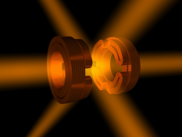
MOT vs. Jet
Supersonic jet
Température ~ 1 K
Résolution Température
Target Gaz rares
State Fundamental
MOT
< 200 µK
Système de détection
Noble Gases, Alkali, rare earth
Fundamental – excited – oriented – aligned
COLTRIMS

Slide 16
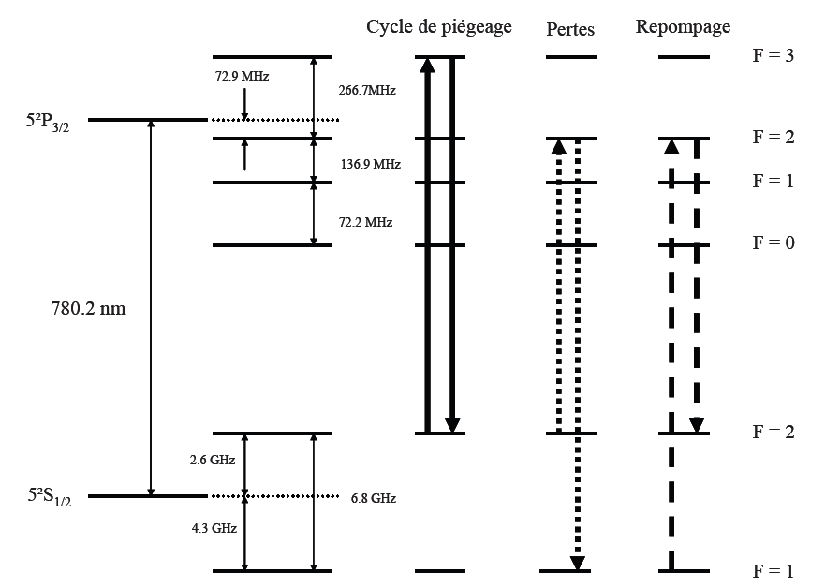
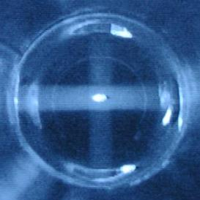
87 Rb Magneto OpticalTrap
Target
CCD camera measurements
Température < 200 µK
Density > 10¹¹ atoms/cm³
Diameter ~ 1mm
Target: fundamental - excited - oriented

Slide 17
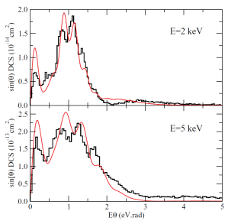
Results
High Resolution
(Collisions Na⁺ + Rb(5s,5p) @ 0.5, 2, et 5 keV)
Na⁺ + Rb(5s,5p) @ 2 keV
Na⁺ + Rb(5s) → Na(3s) + Rb⁺
Rb(5s)
Rb(5p)
Mocc tests (CELIA)
→ Excellent agreement
Diffraction de Fraunhofer
(onde de matière du projectile)
ΔP_{R} = 0.05 u.a. (ΔE_{R} < μeV)
Relative cross sections~ 0.1%

Slide 18

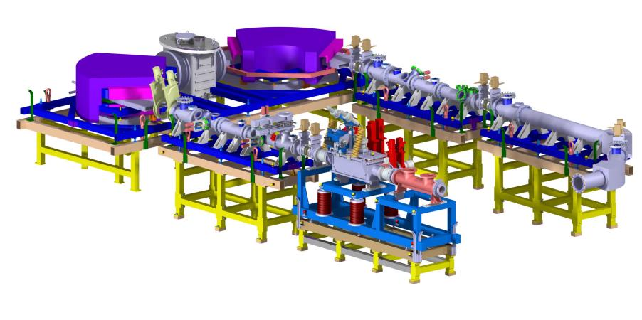
High Intensity Cooling
General view cooler and HRS
HRS
Beam 1+
RFQ cooler

Slide 19
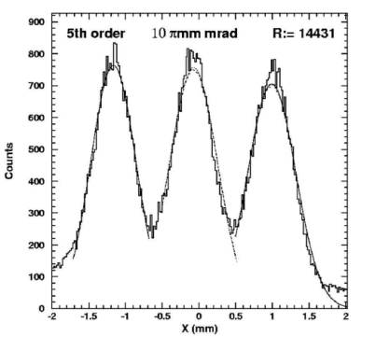
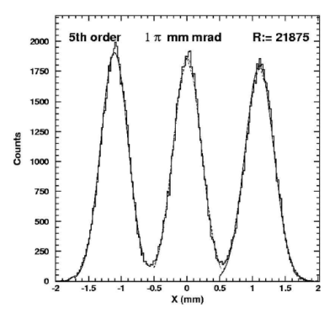
SPIRAL II HIGH INTENSITY COOLER
Calculation by T. Kurtukian Nieto (CENBG)
R ~14400
R ~22000

Slide 20
Requirements for SPIRAL II, Purification
Beams to handle
Emittance
80 πmm.mrad
Intensity
≤ 1µAe
Energy Spread
50eV max
Mass
12 UMA ≤ m ≤ 200 UMA
The ion energy will be between 15 to 43 keV (Singly Charged)
Cooled beams Specifications for the HRS (See next talk) continuous beam
  Emittance: ≤ 3 πmm.mrad
  Energy Spread: 1eV
  Transmission for 1µAe:
      20 % for m ≈ 12 UMA
            40 % for m ≈ 40 UMA
            60 % for m ≥ 90 UMA
Figure of merit for cooling
Extended Brightness
B=T/εΔΕ
B=20

Slide 21
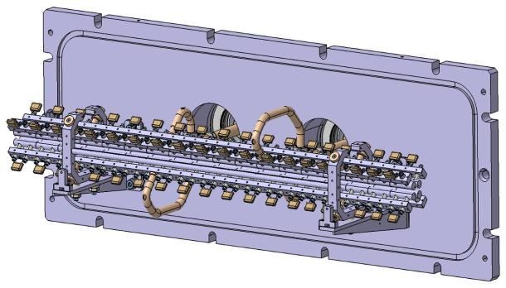
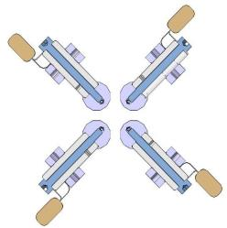
Technical design
18 segments
Beam
Structure support
RF Feed
18 segments Length 40mm
gap = 0.3mm
R _{électrode} = 5.7mm
R₀ = 5mm
Length ~725mm
Pressure a few Pa
Simple extraction
Injection lenses
High Voltage Platform
up to 60 kV
Fully Bakeable
Support rod
Electrode
Insulator
Capacitor

Slide 22
RF system
After numerical simulations space charge for 1µA is too high to have britgh beams
In order to fight the space charge (1µA) we decided to devellop a high voltage
high frequency RF system.
For RF feeding usually a resonant circuit with a ferrite transformer is used
Some limitations are the Vpp, power, ferrite heating
We devellop a circuit with no ferrites the secondary are 2 large copper loops
(10 cm radius) we are able to reach 8kV at 5 Mhz or 6kV at 9Mhz
Configuration | Fmin (MHz) | Fmax (MHz) | V_{RF} max (kV)
2X8 loops | 2.22 | 4.93 | 8
2X5 loops | 2.54 | 6.42 | 7.5
2X2 loops | 3.6 | 8.98 | 6

Slide 23

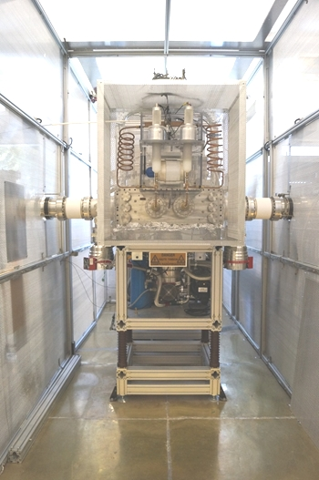
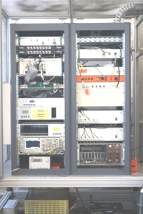
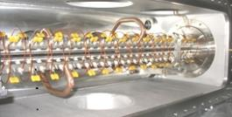
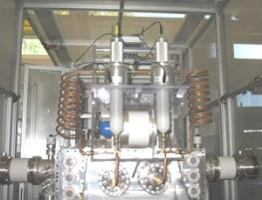
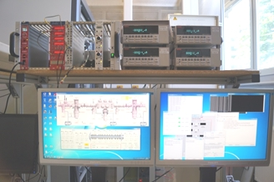
RFQ cooler demonstrator at LPC CAEN
Quadrupole structure
Electronics
RF system
2,1 MHz to 4,9 MHz
Vpp: 8kV
RFQ cooler
Slow control

Slide 24
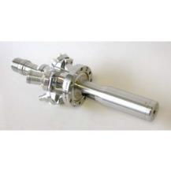
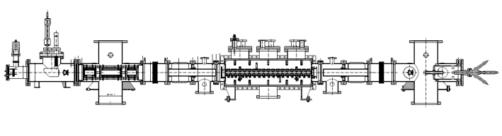
Tests and Measurements
No RIB Available…
Ion surface ionization source, Alkali Cs or K
Curent up to 1µA energy below 5 keV
Several diagonostics to measure
-Transmission
-Emittance
-Energy spread
-cooled beam purity
Emittance-meter
Ion gun
RFQ cooler
Beam
MCP detector with
retarding grid
Faraday cup
Faraday cup
RFQ cooler experimental line

Slide 25
Transmission
Ions K+ @ 5KeV - Pressure=1 Pa – RF frequency= 3,5 MHz
Same kind of results were obtained with heavier ion (Ceasium)

Slide 26
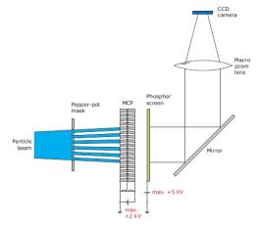

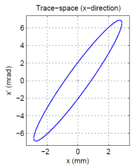
Emittance
Ions K+ @ 5KeV - Pressure=1 Pa – RF frequency= 3,5 MHz
Ion beam intensity (nA) | Transmission (%) | Transverse emittance @ 60 keV (mm.mrad)
50 nA | 74,2 % | 2,09
500 nA | 76,2 % | 2,17
1000nA | 76,4 % | 2,21

Slide 27
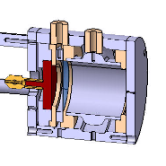
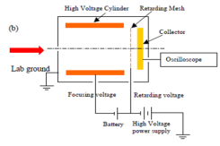
Energy spread measurement with a dedicated detector.
Beam
Beam
Detector principle
Detector
Results:
Ions Cs+ @ 5KeV, RFQ setup: Pressure @ 2Pa & RF @ 3.5 MHz
Ion beam intensity (nA) | Transmission (%) | sigmaE of longitudinal energy spread (eV)
50 | 67 | 0.7
500 | 60 | 1
1000 | 54 | 1.1
sensitivity ~0.6eV
results in within specs

Slide 28
Performance/Requirements
Requirements Present
  Emittance: ≤ 3 πmm.mrad
  Energy Spread: 1eV
  Transmission for 1µAe:
      20 % for m ≈ 12 UMA
            40 % for m ≈ 40 UMA
            60 % for m ≥ 90 UMA
  Emittance: 2 π mm.mrad
  Energy Spread: ~1eV
  Transmission for 1µAe:~70%
  ( mass 40 to 130)
B=20
B=35… beyond specs
Still
Real test will be with the HRS

Slide 29
Nuclear environment
The cooler will be located in a yellow zone and its design has to be adapted
to the heavy radiation environnent
Maintenance, continuous confinement , vinyl sleeve mounting…
limited time for repairs Quick connectors,
Robustness, as simple as possible to limit failure
Gas recycling feasability ok, has to be tested on the device and ions
Deported electronics (slow control)

Slide 30
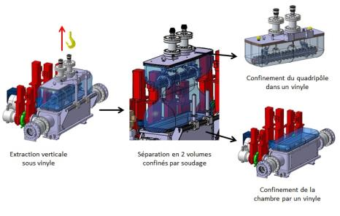
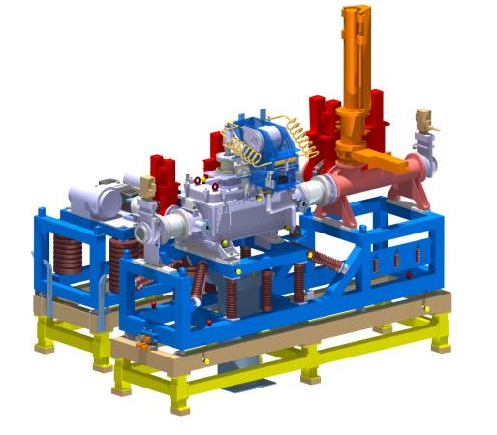
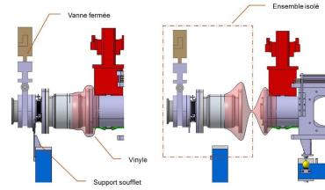
Nuclear environment
Some solutions

Slide 31

Debuncher
From a bunches to a continuous beam

Slide 32
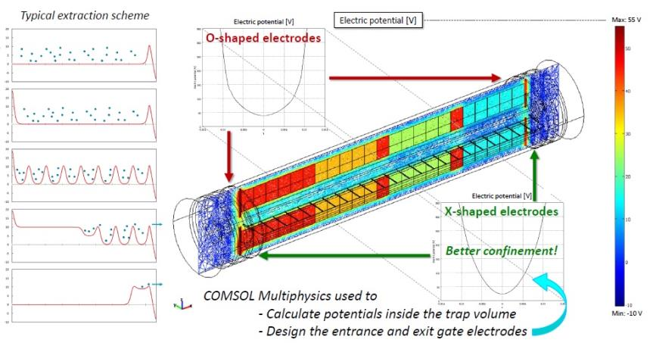
Debuncher
From a bunches to a continuous beam
Principle

Slide 33
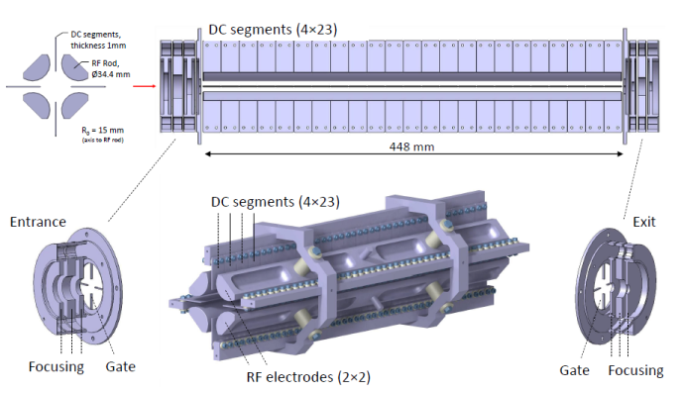
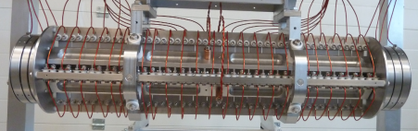
Emilie debuncher quadrupole structure
The quadrupole structure with the wiring

Slide 34
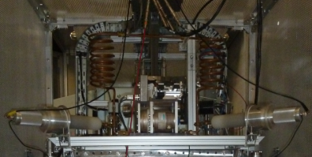
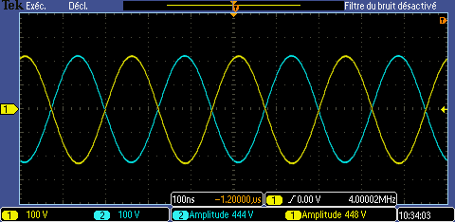
RF system
Production of RF voltages on the quadrupole
RF circuit on the test bench
Principle of the production system RF
Vrf: 450Vpp @ 4MHz
Frequency range: 2MHz to 6 MHz
Voltage range: (pic to pic) : 0 to 2.4kV

Slide 35



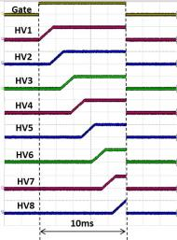

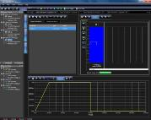
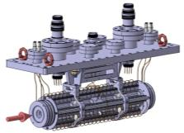
Debunching voltage ramps generator
Goal: Produce 8 voltages ramps (up to 100v/ms)
Sequencer:
delay generator
2x4 channels AWG
LECROY ArbStudio
8 channels voltage
Amplifier 500V
G=50 & BW=15KHz
Wired splitter
8 -> 23 channels
x2
11
12
optical
fiber
link
RF

Slide 36
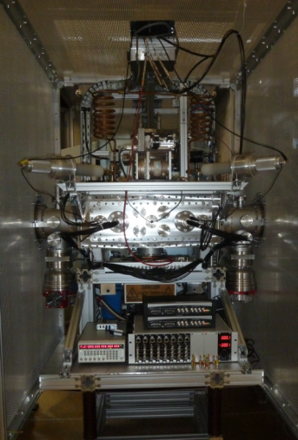
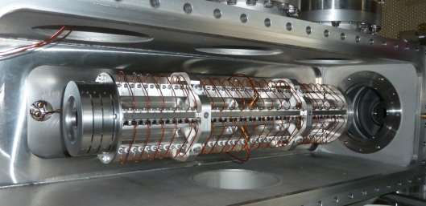
Tests bench (May-June 2015)
Emilie debuncher in SHIRaC vaccum chamber
Debunching voltage ramps generator
Test bunch

Slide 37
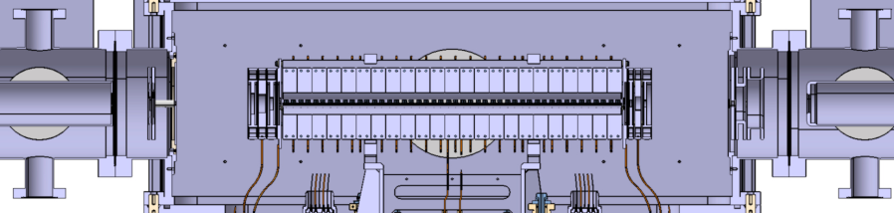

Injection and extraction lenses
Extraction ground electrode
Ion beam
Entrance area
Exit area
A
Transmission: 45%
Transmission with SHIRaC extraction lenses
B
Transmission: 95%
Transmission without SHIRaC extraction lenses
SIMION simulations (by Emil Traykov)

Slide 38


First debunching signal
Experimental beam line
Quadripole triplet
Ion source
Debuncher
700mm
Ion beam
Faraday cup
HV platform
Faraday cup
Mcp

Slide 39






Basic principles of IGLIS @ S³
Provide pure & low energy beams from S³
Perform medium resolution laser spectroscopy
10⁻⁹ mbar
S³ -LEB Phase 0
commissioning
(ANR REGLIS3)
MR ToF MS
(m/Δm ~ 10⁵)
Phase 1
operation
200 - 500 mbar Ar
10⁻⁴ - 10⁻² mbar
10⁻⁷ - 10⁻⁵ mbar
RFQ buncher
bender
gas cell
10⁻² to 1 mbar
diff. pumping
mRFQ
QMF
(m/Δm ~ 200)
Pulse up
(~ 3 kV)
EVRs
S-shape RFQ
Neutralized EVRs
towards Multi Purpose Room - Identification/detection
from
S³
Photoions
towards DESIR
Phase 2
upgrade
λ_{1,2}
in-gas-cell
Ionization
(low resolution)
λ₂
in-gas-jet
Ionization
(medium resolution)
λ₁
Lasers systems:
TiSa dye lasers narrow bandwidth CW

Slide 40








RFQs status
Higher pressure
zone
Ion trajectory simulations with buffer gas completed for REGLIS3
RFQs Assembly : LPC Caen
  S-Shape RFQ
  mRFQ
  EL + QMF + EL
  RFQ-Buncher
  Mobile Thermo-ionic Source (x1)
  Mobile MCP + Faraday Cup (x2)
  Mobile Silicium (x2 ?)
  Laser Mirror 45°
  RF Devices (x4)
  Pumping
  Chambers + Frame + Bellows
Buncher simulations
Completed end of 2015
Einzel Lens
Silicium Mobile
45° Mirror
Bent @76°
RFQ-Buncher
Mobile ion source
mRFQ
Mobile MCP-FC
S-Shape RFQ
Einzel Lens
QMF
3D study almost completed

Slide 41








RFQs status
REGLIS3 RFQs: design validated, manufacturing ongoing @ LPC
→ Start tests with RF & gas in November-December
REGLIS3 diagnostics & RFQbuncher
→ Final 3D study in progress

Slide 42





RFQs status: RF, vacuum & slow control
Based on resonant RF circuit
Study in progress
2 circuits→ 0.4-1.3 MHz / 1.3 kVptp / ~20 Watts
Covers all masses from A=40 to A>300
→ Validation with real RFQ structures in November
RFQs vacuum calculations completed
Vacuum system → validated
REGLIS3 slow control→ under study
(architecture validated)

Slide 43







MR-ToF-MS (PILGRIM)
Simulations and mechanical design → completed
Assembly → ongoing
Slow control → under development
Offline tests @LPC (K⁺ & Ca⁺) → first semester 2016
Pulsed
offline source

Slide 44




RFQs simulations (E. Traykov)
S-shape RFQ
Transmission: 80% ÷ 100%
Background gas pressure (Argon): 0.01 ÷ 0.1 mbar
U_{RF} = 100 ÷ 800 V, f_{RF} = 0.5 ÷ 1 MHz
Cooled beam at exit of SRFQ
mRFQ
Transmission: 100%
Small r₀ = 3 mm
Differential pumping measured
Steering possibility
QMF
Transmission: 80 - 100%
Resolving power > 200
f_{RF} same as SRFQ, mRFQ
Novel operation modes → R > 1500 (ε ≈ 80%)
(technically demanding, to be tested)
RFQ-Buncher
Higher pressure zone
Compact dimensions & Bending beam axis
Small apertures for differential pumping
Low gas pressure operation
Buncher section to be studied along with pulse up electrode & MR-ToF-MS

Slide 45
RFQs status: Vacuum , Command & Control
Screw P
Screw P
Scroll P
Automatic inlet isolation valve
ISO160
ISO100
Automatic inlet isolation valve
KF40
Automatic safety valve
KF25
KF40
KF16
KF25
KF16
KF25
P
KF40
P
P
P
P
P
KF16
TP
TP
TP
TP
TP
???
CF40?
CF250
CF40
CF100
CF200
CF40
CF100
CF200
CF40
E lens 1
Buncher
Gas Cell + sRFQ
mRFQ
QMF
E lens 2
P
F
F
F
F
F
Manual valve
N₂
He
Venting controled valve
CF16
CF16
Pumping Controled valve
P
Primary gauge
Gate valve
F
Full range gauge

Slide 46



REGLIS3 – S-Shape RFQ
RF Rigid Conductor (x4)
Capacitor + Elec. Resistance
Side plate (x2)
Entrance electrodes (x2)
45° mirror
Flasque
Manufacturing in progress in LPC workshop
Emil Traykov

Slide 47



REGLIS3 – mRFQ
Emil Traykov
RF Rigid Conductor (x4)
mRFQ Entrance Rods
PCB Plate (x4)
Manufacturing in progress in LPC workshop
CMS Elec. Resistances on PCB
Capacitors

Slide 48




REGLIS3 – EL+QMF+EL
Einzel Lens
QMF
Einzel Lens
Einzel Lenses : Manufacturing in progress in LPC workshop
QMF : Study finished - Manufacturing in LPC workshop in November
Emil Traykov

Slide 49



REGLIS3 – RFQ-Buncher
Buncher
76°
Cooler
Study in progress
Missing inputs:
Simulations of
- Buncher structure
- Transfer line to MR-ToF
0°
Sketch
Emil Traykov

Slide 50

REGLIS3 – RFQs Vacuum system
(Pressure estimate based on differential pumping measurements & calculations)
P < a few mbars?
P < 10⁻² mbar
P < 10⁻⁶ mbar
P < 3.10⁻³ mbar (outside cooler)
P < 2.10⁻⁴ mbar
P < 10⁻⁴ mbar
P < 3.10⁻² mbar (inside cooler)
Full range gauge
Turbo 2300 CF250
(STP-iXA3306)
+ Valve ?
Turbo V300 CF100
+ Valve
Turbo V1000 CF200
+ Valve
Turbo V300 CF100
+ Valve
Turbo V1000 CF200
+ Valve

Slide 51

REGLIS3 – RFQs Vacuum
Differential pumping measurements & simple calculations were used to determine
pumping speed requirements

Slide 52
REGLIS3 – Slow control
Primary
pump
X1
Gate valves
&
translations
DC power supplies for RFQ
Crate Wiener MPOD
?
TOR
Motor
CAPA
X4
Motor
Gas Cell
Gas cell
Pumps
(roots & screw)
?
?
Crates
x3
ETHERNET
RS485
Chassis PXIe-1065
Pxi 8431/8
RS485
Pxi 8431/8
RS485
Pxi 8430/8
RS232
Pxi 5402
Gene 20 MHz
OSCILO X2
PXIE 8135 Win 7 64 bit
Pxi 6528
Pxi 6528
Pxi 6528
Pxi 5402
Gene 20 MHz
Switch
Ethernet
Pxi 5402
Gene 20 MHz
Pxi 5402
Gene 20 MHz
?
ETHERNET
N°1
N°2
N°3
BNC
ETHERNET
RS485
RS485
RS232
Gauge
crates
X2
?
Brooks
x1
Pumps PFEIFFER
X4
RF AMPLI
X3
(Buncher X1)
Acquisition
PC
(Control based on LabWindows CVI software)

Slide 53
Conclusion
All kind of trapping and cooling devices have been develloped, constructed
and run at LPC
Applications range from Particle to atomic physics and beamlines
With some breakthrough results
Long time expertise in the field

Slide 54












THANKS for
Your Attention
and to
all the contributors of these developments

