Slide 1
Research of CB ECRIS plasma with the aid of injected 1+ beam
H Koivisto¹, O Tarvainen¹, T Lamy², J Angot², T Thuillier², P Delahaye³, L Maunoury³, J Choinski⁴, L Standylo⁴, A Galatà⁵, G Patti⁵
Emilie collaboration
1 University of Jyväskylä, Department of Physics, 40500 Jyväskylä, Finland
2 LPSC, Université Grenoble-Alpes, CNRS/IN2P3, 53 Rue des Martyrs, 38026 Grenoble Cedex, France
3 GANIL, CEA/DSM-CNRS/IN2P3, Caen Cedex 05, France
4 Heavy Ion Laboratory, University of Warsaw, 00-927 Warszawa, Poland
5 INFN-Laboratori Nazionali di Legnaro, 35020 Legnaro PD, Italy

Slide 2
Global efficiency measurements with LPSC CB ECRIS
What happens?
An anomalous global efficiency of the extracted 1+ beam was discovered at the LPSC charge breeder.
Different characteristics for neutral and 1+ beam injection
It was assumed and later confirmed that a fraction of injected 1+ beam propagates through the charge breeder plasma (oxygen) without being captured and ionized.
Can we use this as a diagnostic tool?
Koivisto H et al 2014 Rev. Sci. Instrum. 85 02B917
Krypton ion beam intensities measured after CB

Slide 3
Experimental setup of LPSC 14.5 GHz PHOENIX CB-ECRIS
to study the properties of 1+ beam
Was used, for example, to define the breeding time

Slide 4
Similar anomalous 1+ behavior was confirmed with the solid elements
Assumption: these ions propagate through CB “without” interacting with plasma
Assumption: In-flight ionized
Rb
Cs
Similar behavior of injected 1+ beam with solid elements
The result indicates that anomalous effect can be connected to plasma processes (not to wall effect). Fraction of 1+ beam propagates through the plasma without capture and ionization process

Slide 5
Normalised production efficiency as a function of ΔV
“Beam components”
“Plasma components”
Figure: Normalized intensities of various charge states of rubidium (⁸⁵Rb) and cesium(¹³³Cs) ions, measured after the mass separation of CB, as a function of ΔV.
Note the drastically different behavior of 1+ and 2+ ions when compared to high charge states.

Slide 6
“Breeding” time: low vs high charge states
Captured 1+ ions strongly
modify the plasma!
Figure: Breeding times of low and high charge state ¹³³Cs ions.
Note: Behavior of 1+ and 2 plasma are practically identical with and without the plasma
Indicates that fraction of 1+ and 2+ beams propagates through the plasma without any processes affecting the time the ion stays inside the charge breeder.

Slide 7
Theoretical explanation for efficiency vs ΔV behavior
Slowing down coefficient in ion-ion collisions (can be associated with beam “component” to plasma “component” transition, i.e to capture efficiency )
where
with
and a refer to 1+ component
R(u_{ab}) reaches a maximum when longitudinal component of the incident ion velocity,
v_{a,∥}, equals the average velocity of the plasma ions 〈v_{b} 〉.
Note strong charge state dependence!

Slide 8
Experimental data versus theoretical curve
Experimentally recorded, normalized charge breeding efficiency of Rb²⁰⁺ together with normalized R(u_{ab})- factor
O Tarvainen et. al., Plasma Sources Sci. Technol. 24 (2015) 035014
By ΔV tuning we are maximizing the slowing down coefficient!

Slide 9
Concept of reaction cross section σ and mean free path λ
A particle having a “diameter” of ζ suffers a reaction with another particle if anywhere its center is within distance ζ of the center of another particle. Therefore it sweeps out, without collision, a cylinder of diameter 2ζ. We obtain that the cross section for the reaction is:
The volume V of the cylinder is:
v
2ζ
The number of reactions the particle
experiences during the path L is:
L=vt
(n_{particles} = density of target particles)
Velocity of particle (1+ beam)
Distance between the subsequent reactions, i.e. mean free path λ is:
σ [m²]: any cross section
n [1/m³]: density of any targets
Note: In this case the target particle is not moving. If projectile and target atoms have same velocities the equation has to be divided by 2^{1/2}

Slide 10
Concept of reaction cross section σ and mean free path λ
Lets find out how the 1+ intensity decreases when it propagates through the plasma
The probability P for (any) reaction is:
The intensity I decreases as:
Intensity has dropped to 1/e (from it’s original value) when beam has propagated the distance of x = λ
By the integration we obtain:
=1/λ
(slow background, “fast” beam)
This gives the decay of intensity due to (intensity decreasing) reactions inside the CB. Can be used to find out the mean free path…
II/10

Slide 11
Mean free path λ_{c} for collisional capture (for 1+ beam)
Injected 1+ beam is mainly disturbed by two processes: 1) ion-ion collisions and 2) electron impact ionizations (in-flight). Lets “forgot” ionization at this point (for simplicity)
Transported 1+ intensity with and without plasma
where λ_{i} is mean free path for in-flight ionization and L effective plasma length
(from optimum slowing down coefficient)
Using the experimental data (behavior of injected 1+ beam intensity), and frequency scaling of collisions ( ) we can calculate the mean free path (upper limit because we assume single collision) for ion-ion collisions, collision frequency and minimum electron density.

Slide 12
Parameters obtained from 1+ vs deltaV behavior
Ion-ion collision mean free path for 1+ beam (≈ intensity dropped to value of 36 %)
Ion-ion collision frequency (minimum)
Transition charge state (magnetized -> non-magnetized)
Minimum plasma density
[mm]
[MHz]
[MHz]
[1/cm³]
[mm]

Slide 13
Mean free path and (minimum) collision frequency as a function of charge state
For more information see: O Tarvainen et. al., Plasma Sources Sci. Technol. 24 (2015) 035014

Slide 14
The effect of ionizing collisions on the estimated plasma parameters.
Estimated in-flight correction factor:
σ: ionization cross section
v_{e}: electron velocity
v_{i}: injected 1+ velocity (optimized velocity)
: rate coefficient
O Tarvainen et. al., Plasma Sources Sci. Technol. 24 (2015) 035014

Slide 15
Maximum electron density
Earlier we got minimum electron density of plasma. How to get the upper limit?
Lets make an assumption: we must first ionize the 1+ ion to charge state 2+ in order to increase the capture probability. Now we can define the electron density because we know:
Mean free path from the experiments
Optimal ion velocity from slowing factor equation (ΔV has been optimized)
Ionization rate coefficient
As a result the upper limit for electron density shows below can be calculated

Slide 16
Injection efficiency of lighter 1+ beam and lighter mixing gas element (main plasma component)
Na¹⁺ injected into He plasma (6 eV)
N_{e}: 1.6 . 10¹¹ to 4.4 . 10¹¹
Comparison to Rb injection:
O. Tarvainen et. al., accepted for publication in Phys. Rev. Acceler. and Beams
Rb¹⁺ injected into O plasma (8 eV)
N_{e}: 1.2 . 10¹¹ to 3.2 . 10¹¹
Power [W] | 150 | 250 | 350 | 470
λ_{Rb1+} | 132 | 84 | 62 | 48
ν_{ii,} _{Rb1+} | 14 | 22 | 30 | 38

Slide 17
Measured and simulated Na¹⁺ transport efficiency as a function of ΔV
Global efficiencies:
Na in He: 20-30 %
Rb in O: 50-60 %
Possible explanation for lower capture efficiency:
Lower average charge state of He plasma.
P_{µ}: 470 W
O. Tarvainen et. al., accepted for publication in Phys. Rev. Acceler. and Beams
Simulations by A. Galata

Slide 18
Measured and simulated Na¹⁺ transport efficiency as a function of ΔV
Good agreement between simulations and experimental data

Slide 19
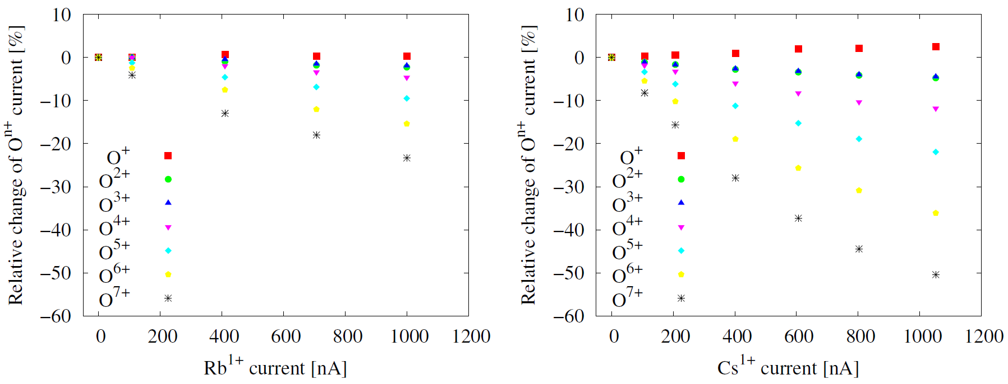
Effect of injected heavier element on the intensity of the mixing gas element
Beam currents of the buffer gas species are affected by the 1+ injection
The magnitude of the effect follows the injected current linearly
This is probably due to gas mixing effect which is believed to affect the confinement times of both the heavier and lighter species

Slide 20
Question for future experiments
Can we use 1+ injection and charge breeding to study the gas mixing effect on ion confinement times?

Slide 21
Particle balance equation for charge state q
Loss term defined by ion confinement time
How to measure the confinement time with the 1+ injection method?
Switch on the 1+ injection (preferable alkali metal)
Wait until high charge state currents have been saturated
Switch off the 1+ injection
Measure the decay constant immediately following the trailing edge of the 1+ pulse.
Obtain ion confinement time.

Slide 22
If the procedure is repeated with different buffer gas / injected ion species combinations, the effect of gas mixing on the ion confinement time can be measured at least qualitatively.
First direct measurement of the effect!
Can be performed also with a conventional ECRIS using a pulsed sputter sample and the results can be compared to separate the gas mixing effect on the capture and confinement.

